Slide 1
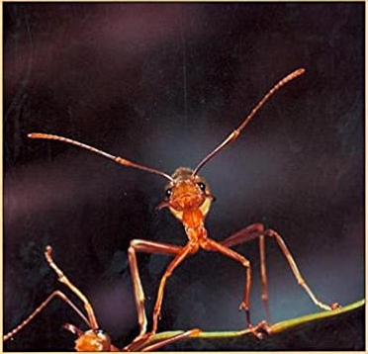
Ant Interactions
Interaction networks predict optimal foraging behavior

Slide 2
Project Purpose
Is the speed at which foragers change their foraging rate adaptive?
Can graph metrics predict when ants become foragers in the first place?

Slide 3
Key Facts for Context
Ants operate without central information or directives
Contrary to popular misconceptions (and movies), the queen does not run the colony!
Ants have different roles in the colony
Some are “foragers” that search for food
Some are nurses that tend to larva
Some are cleaners that maintain the nest
The queen(s) are the sole fertile members of the colony
Not all ant foragers are active at once!
Foragers are typically the oldest ants in the colony

Slide 4
Red Harvester Ants
Occur primarily in the desert in the southwestern U.S. and northern Mexico
Eat seeds that are deposited by wind or floods
Have non-overlapping foraging ranges with other ant colonies
Did not face significant competition from other ant species until the introduction of the invasive Argentine Ant species in 1907

Slide 5
Key questions
If the rate at which successful foragers return starts to increase, more foragers will leave the nest
The adjustment takes place very rapidly. Is the speed of the adjustment adaptive?
When do ants become foragers in the first place?

Slide 6
Ant interaction
Mersch et. al. grew 6 colonies in a lab, which consisted of 122 to 192 workers per colony
Workers were tagged with RFID tags and recorded
An interaction between ants occurred when the front end of an ant was in close proximity to another ant
Colonies were observed for 41 days
In the video on the next slide, an interaction is shown by a yellow line that joins two ants
To illustrate how information is spread, a single ant is shown in blue in the upper right-hand corner initially. An ant becomes “infected” with the information that the ant has when they interact with another infected ant.

Slide 7
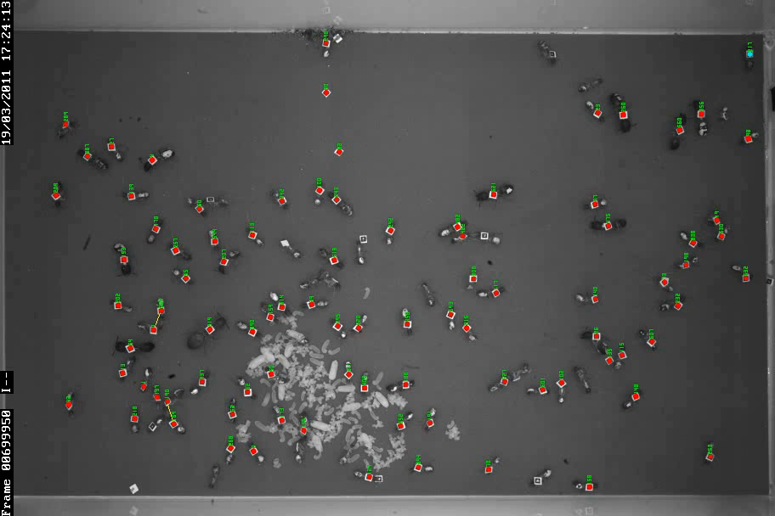

Slide 8
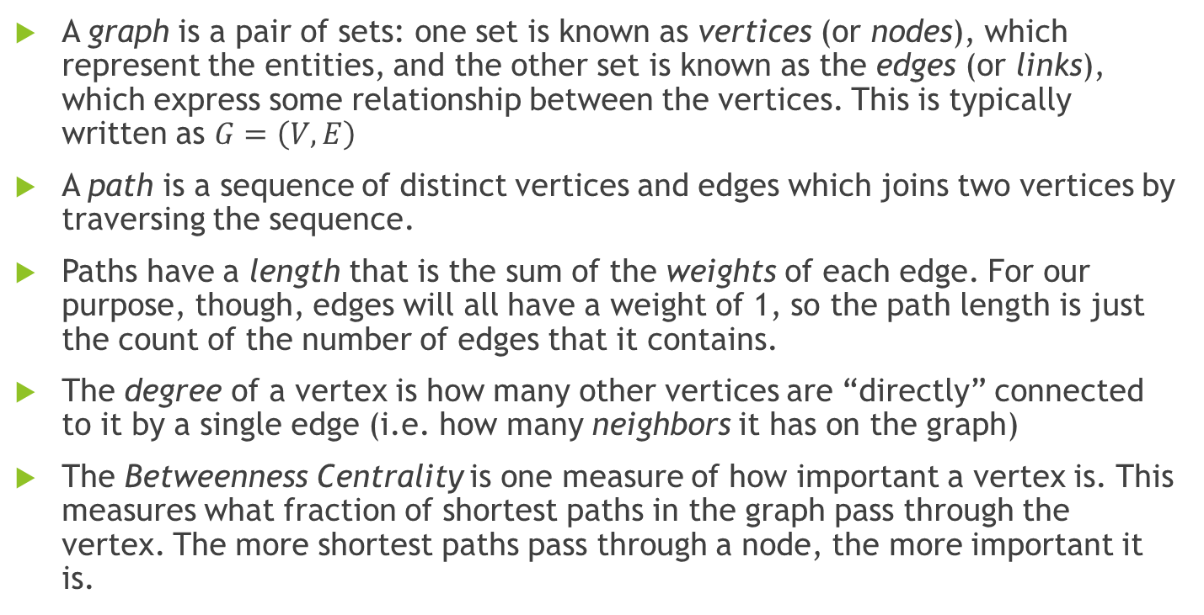
Some terminology
A graph is a pair of sets: one set is known as vertices (or nodes), which represent the entities, and the other set is known as the edges (or links), which express some relationship between the vertices. This is typically written as $G=\left(V, E\right)$
A path is a sequence of distinct vertices and edges which joins two vertices by traversing the sequence.
Paths have a length that is the sum of the weights of each edge. For our purpose, though, edges will all have a weight of 1, so the path length is just the count of the number of edges that it contains.
The degree of a vertex is how many other vertices are “directly” connected to it by a single edge (i.e. how many neighbors it has on the graph)
The Betweenness Centrality is one measure of how important a vertex is. This measures what fraction of shortest paths in the graph pass through the vertex. The more shortest paths pass through a node, the more important it is.

Slide 9
Communities
A community is a subset of the nodes that are more densely connected to each other than they are to other communities. Some common
Hierarchical clustering
Girvan-Newman Algorithm (based on a generalization of Betweenness Centrality)
Infomap algorithm (based on clustering)

Slide 10
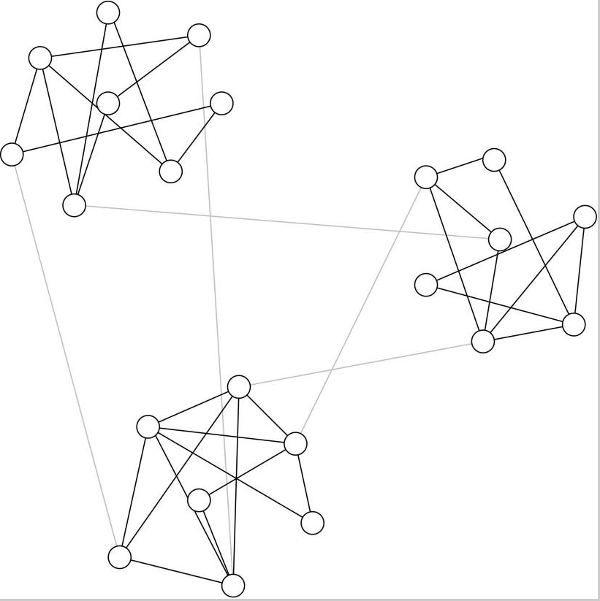
An example from Girvan and Newman

Slide 11
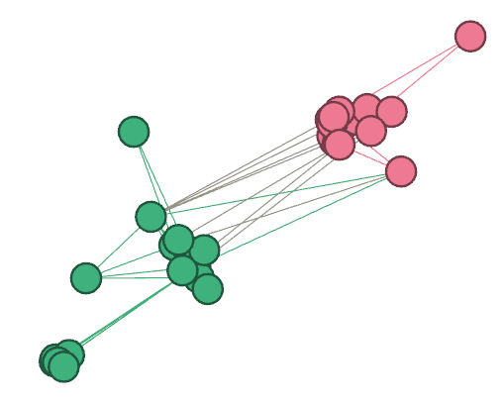
Zachary’s Karate Club

Slide 12
Community detection problems
Detecting communities tends to be very computationally intensive
Inherits many problems from clustering algorithms
Many ways to cluster/split into communities – can be somewhat subjective which one is “correct”
Will find clusters/communities even if they don’t “exist” in the data (which is why other algorithms, like VAT, are sometimes used to make sure that there are “really” clusters in the data)

Slide 13
How did Mersch et. al. determine their categories of ants?
Based on the primary behavioral repertoire of the ants (foraging, cleaning the nest, or tending to the queen and larva)
They Infomap community detection algorithm to help sort ants into foragers, cleaners, or nurses
This provides a good illustration of the problems that we can face with community detection algorithms: I was able to detect a large number of possible communities on their data set, which varied significantly by day. Which one is “correct” can be a little bit subjective. In this case, we have to look at the behavioral repertoire to decide which one is correct – the algorithm alone won’t really tell us.

Slide 14
Communities detected using the Girvan-Newman Method (not even normally distributed ☹)
Goodness-of-Fit Tests for Normal Distribution
Test | Statistic |  | p Value
Kolmogorov-Smirnov | D | 0.11205721 | Pr > D | <0.010
Cramer-von Mises | W-Sq | 0.20871995 | Pr > W-Sq | <0.005
Anderson-Darling | A-Sq | 1.58786002 | Pr > A-Sq | <0.005

Slide 15
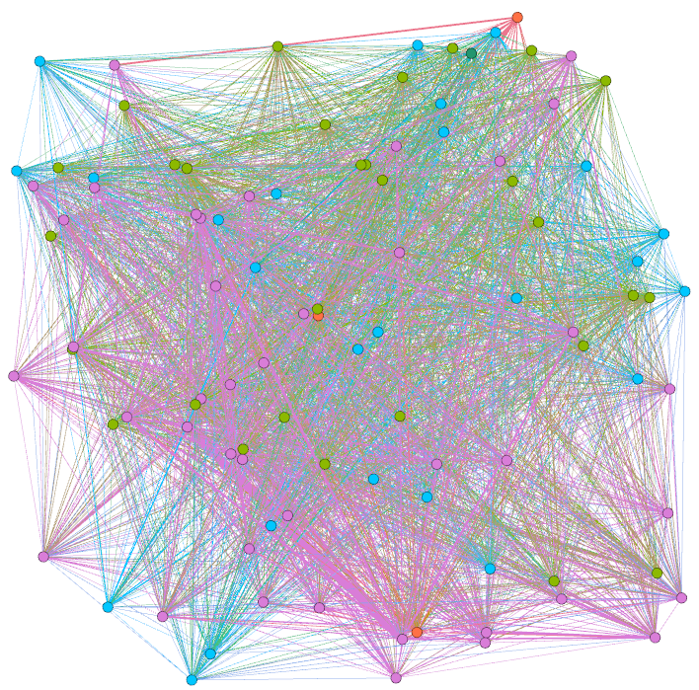
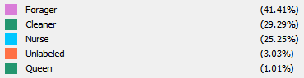
How ants interact

Slide 16
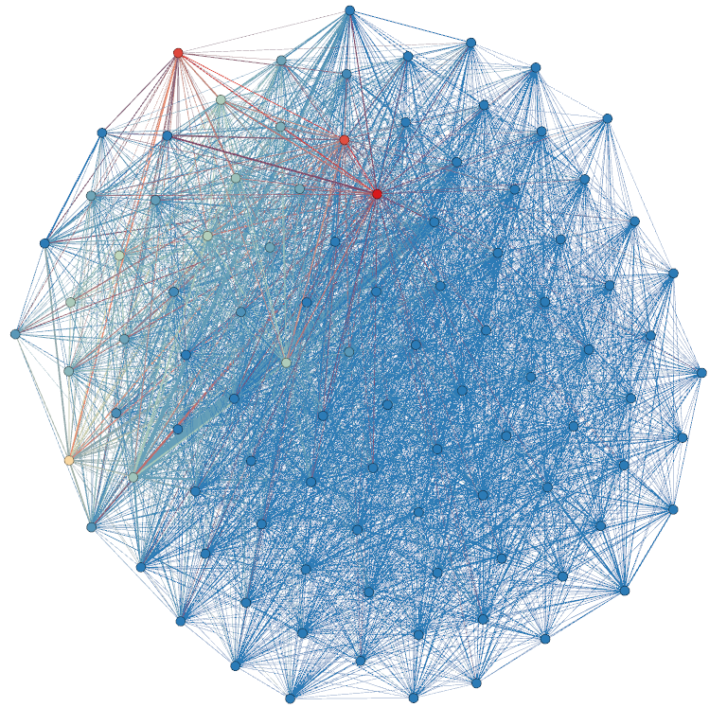

Not all ants forage equally

Slide 17
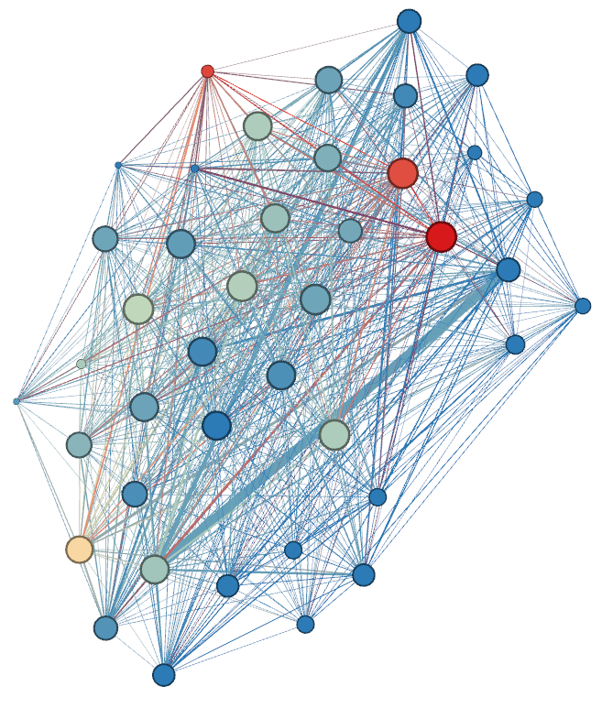
Not even all foragers forage equally

Slide 18
What does this tell us?
Size represents the degree of the ant (i.e. the number of interactions with other ants)
Color represents the number of foraging events
Clearly, some ants are foraging more than others are, and some are interacting more than others
Some ants may help to spread information around the nest quickly, and some may help to move lots of product quickly

Slide 19
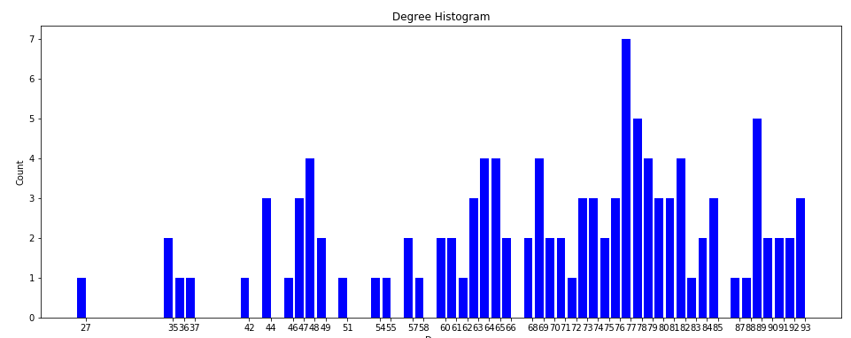
How often do ants interact?

Slide 20
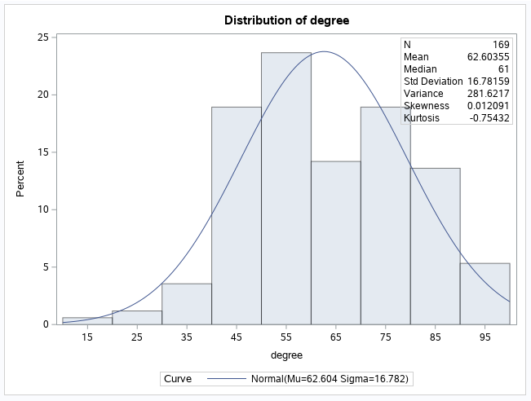
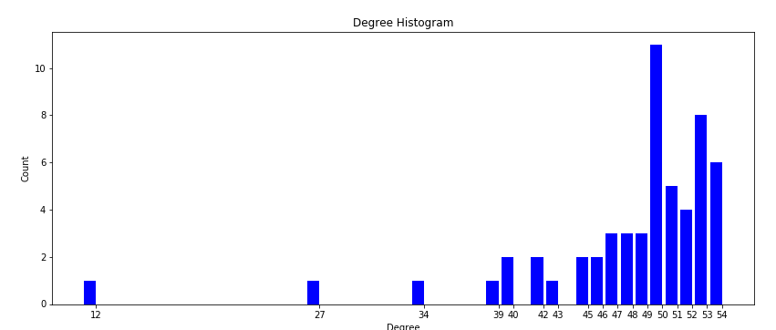
How often do foragers interact?
Goodness-of-Fit Tests for Normal Distribution
Test | Statistic |  | p Value
Kolmogorov-Smirnov | D | 0.15153301 | Pr > D | <0.010
Cramer-von Mises | W-Sq | 0.54601769 | Pr > W-Sq | <0.005
Anderson-Darling | A-Sq | 2.95194971 | Pr > A-Sq | <0.005

Slide 21
How do foragers interact?
Usually quite frequently
Not uniformly, or even normally
Not all foragers are created equal!

Slide 22
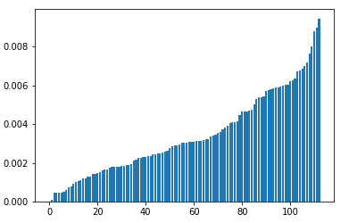
How important are different ants? (Betweenness Centrality of individual ants)

Slide 23
Why do ants forage the way they do?
The famous “six degrees of separation” discovered by Stanley Milgram applies even more extremely to ants
Human social networks and ant interaction networks are both examples of “small-world networks”
High clustering (“my friends’ friends are also friends”)
Short average shortest path lengths (“six degrees of separation”) – 1.1253 for (admittedly small) ant colonies in Mersch et. al. vs. 5.2 for humans
Harvester ant foraging networks are as efficient as the human highway system in terms of total amount of trail and the average distance between the nest and (Buhl et. al. 2008)
Overall, their efficiency is quite impressive

Slide 24
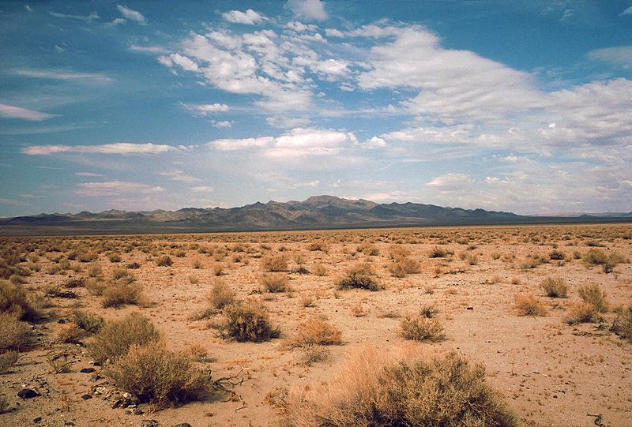
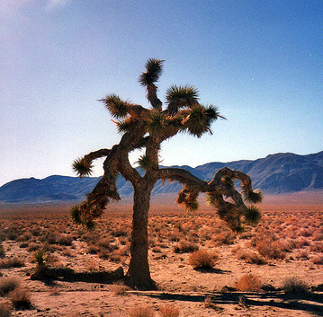
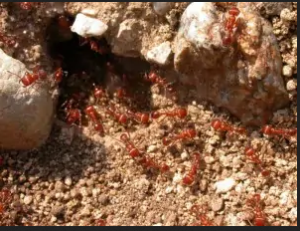
Red Harvester Ant climate: dry and hot (need to conserve water)

Slide 25
What’s the best way to forage?
Tradeoff between energy expenditure and food intake
An optimal foraging strategy gets the highest “bang for the buck” – the most food possible for the least amount of energy possible
The solution?
Send out more foragers when food is plentiful and fewer when it’s scarce
In fact, that’s exactly what they do

Slide 26
How do ants know whether food is plentiful?
By seeing how many foragers are successfully returning with food! If the rate of successful foragers increases, it must mean that average foraging trips are shorter and food is easy to find.

Slide 27
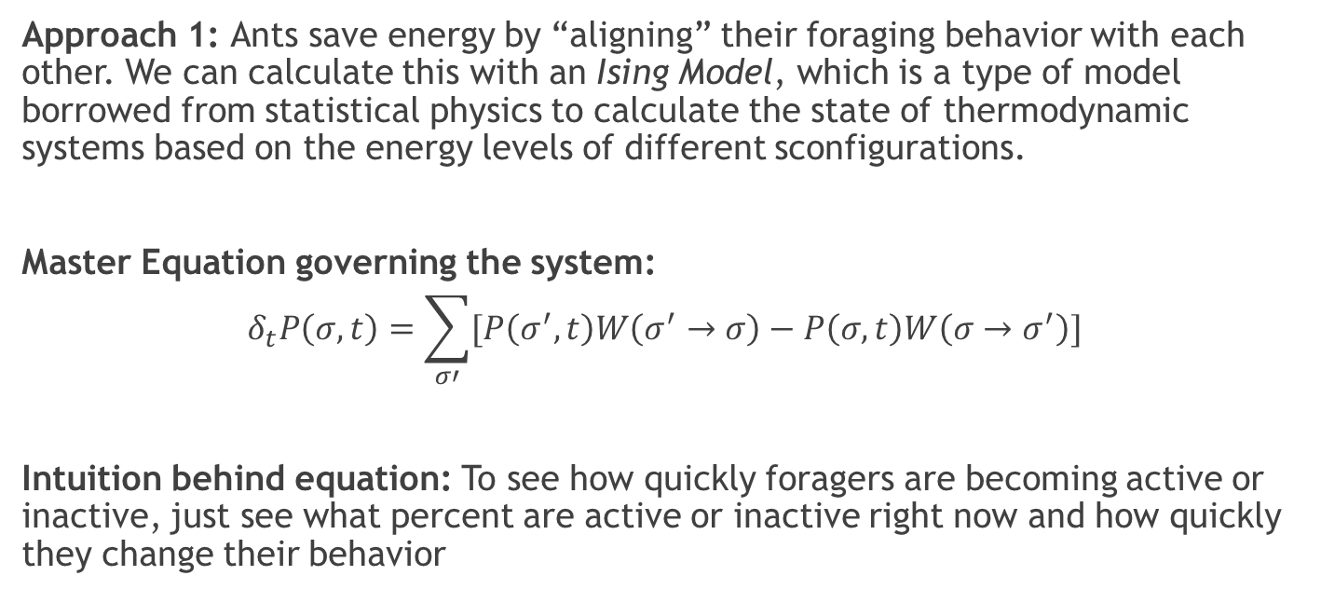
How do we figure out how many foragers to send out?
Approach 1: Ants save energy by “aligning” their foraging behavior with each other. We can calculate this with an Ising Model, which is a type of model borrowed from statistical physics to calculate the state of thermodynamic systems based on the energy levels of different sconfigurations.
Master Equation governing the system:
$$δ_{t}P\left(σ, t\right)=\sum_{σ′}{[P\left(σ^{′}, t\right)W\left(σ^{′}→σ\right)−P\left(σ, t\right)W\left(σ→σ^{′}\right)]}$$
Intuition behind equation: To see how quickly foragers are becoming active or inactive, just see what percent are active or inactive right now and how quickly they change their behavior

Slide 28
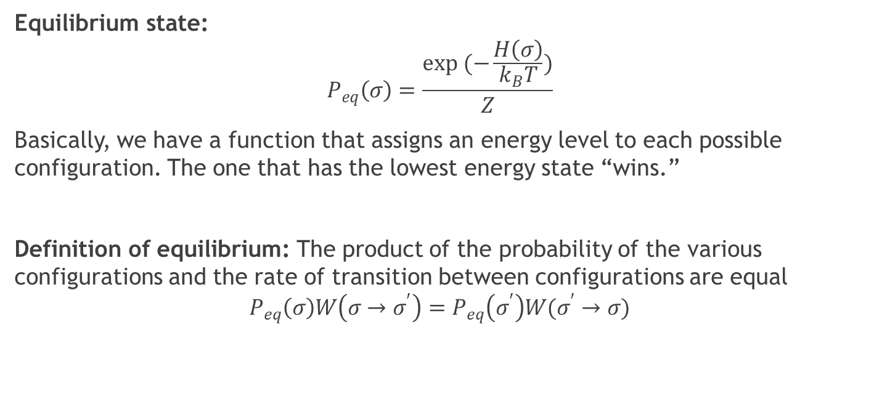
Equilibrium state
Equilibrium state:
$$P_{eq}\left(σ\right)=\frac{exp (−\frac{H\left(σ\right)}{k_{B}T})}{Z}$$
Basically, we have a function that assigns an energy level to each possible configuration. The one that has the lowest energy state “wins.”
Definition of equilibrium: The product of the probability of the various configurations and the rate of transition between configurations are equal
$$P_{eq}\left(σ\right)W\left(σ→σ^{′}\right)=P_{eq}\left(σ^{′}\right)W(σ^{′}→σ)$$

Slide 29
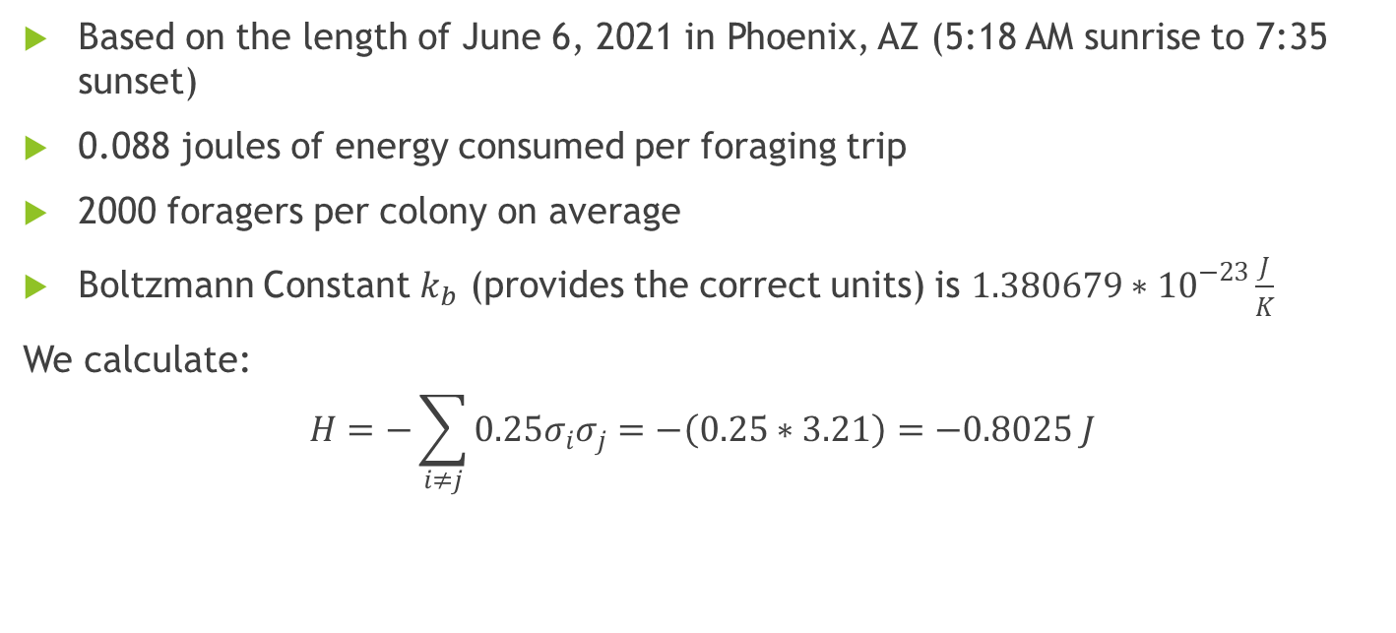
Full computation (details found in the paper)
Based on the length of June 6, 2021 in Phoenix, AZ (5:18 AM sunrise to 7:35 sunset)
0.088 joules of energy consumed per foraging trip
2000 foragers per colony on average
Boltzmann Constant $k_{b}$ (provides the correct units) is $1.380679∗{10}^{−23}\frac{J}{K}$
We calculate:
$$H=−\sum_{i≠j}{0.25σ_{i}σ_{j}=−\left(0.25∗3.21\right)=−0.8025 J}$$

Slide 30
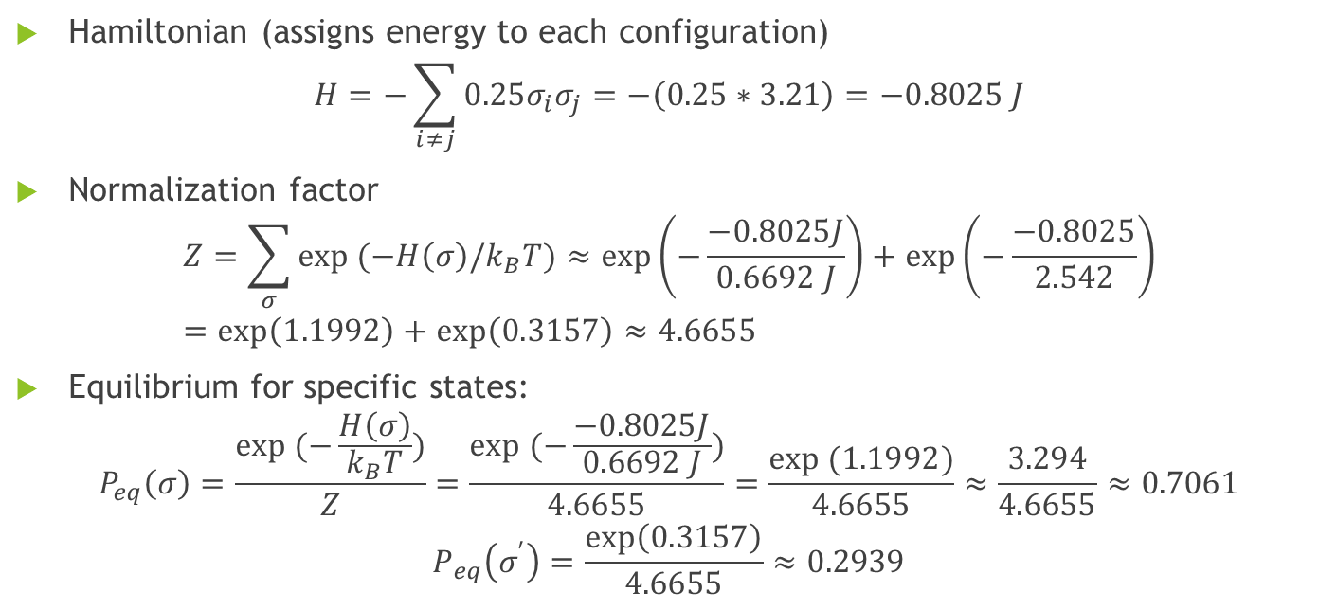
Calculations
Hamiltonian (assigns energy to each configuration)
$$H=−\sum_{i≠j}{0.25σ_{i}σ_{j}=−\left(0.25∗3.21\right)=−0.8025 J}$$
Normalization factor
$$Z=\sum_{σ}{exp (−H\left(σ\right)/k_{B}T})≈\exp\left(−\frac{−0.8025J}{0.6692 J}\right)+\exp\left(−\frac{−0.8025}{2.542}\right)=\exp\left(1.1992\right)+\exp\left(0.3157\right)≈4.6655$$
Equilibrium for specific states:
$$P_{eq}\left(σ\right)=\frac{exp (−\frac{H\left(σ\right)}{k_{B}T})}{Z}=\frac{exp (−\frac{−0.8025J}{0.6692 J})}{4.6655}=\frac{exp (1.1992)}{4.6655}≈\frac{3.294}{4.6655}≈0.7061$$
$$P_{eq}\left(σ^{′}\right)=\frac{\exp\left(0.3157\right)}{4.6655}≈0.2939$$

Slide 31
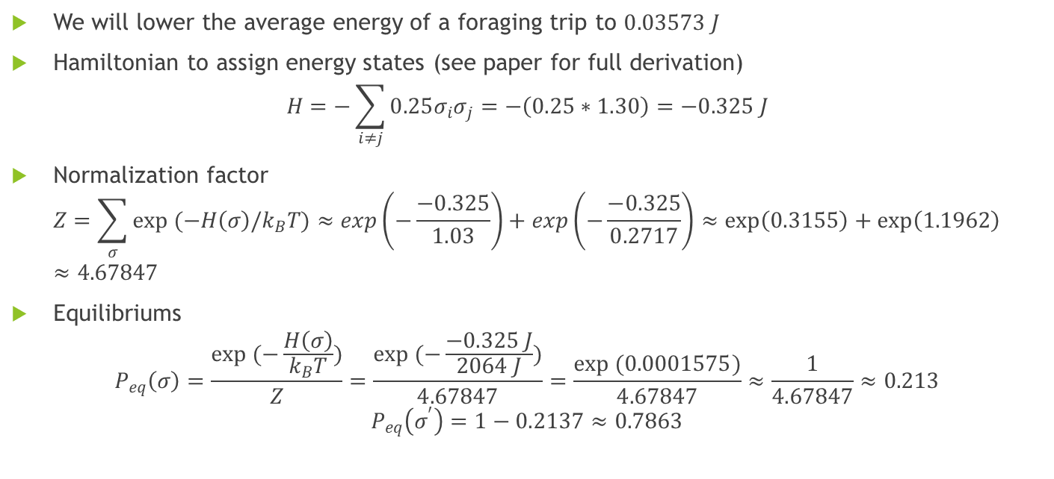
What happens if it takes ants much less time to collect food?
We will lower the average energy of a foraging trip to $0.03573 J$
Hamiltonian to assign energy states (see paper for full derivation)
$$H=−\sum_{i≠j}{0.25σ_{i}σ_{j}=−\left(0.25∗1.30\right)=−0.325 J}$$
Normalization factor
$$Z=\sum_{σ}{exp (−H\left(σ\right)/k_{B}T})≈exp\left(−\frac{−0.325}{1.03}\right)+exp\left(−\frac{−0.325}{0.2717}\right)≈\exp\left(0.3155\right)+\exp\left(1.1962\right)≈4.67847$$
Equilibriums
$$P_{eq}\left(σ\right)=\frac{exp (−\frac{H\left(σ\right)}{k_{B}T})}{Z}=\frac{exp (−\frac{−0.325 J}{2064 J})}{4.67847}=\frac{exp (0.0001575)}{4.67847}≈\frac{1}{4.67847}≈0.213$$
$$P_{eq}\left(σ^{′}\right)=1−0.2137≈0.7863$$

Slide 32
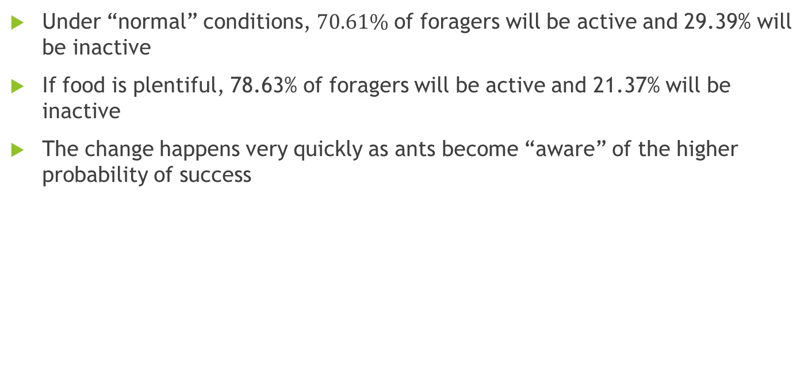
What does this all mean?
Under “normal” conditions, $70.61\%$ of foragers will be active and 29.39% will be inactive
If food is plentiful, 78.63% of foragers will be active and 21.37% will be inactive
The change happens very quickly as ants become “aware” of the higher probability of success

Slide 33
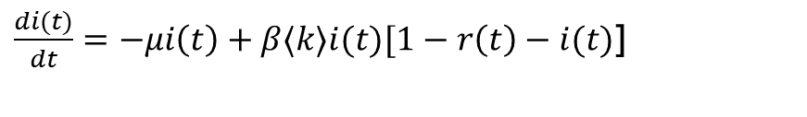

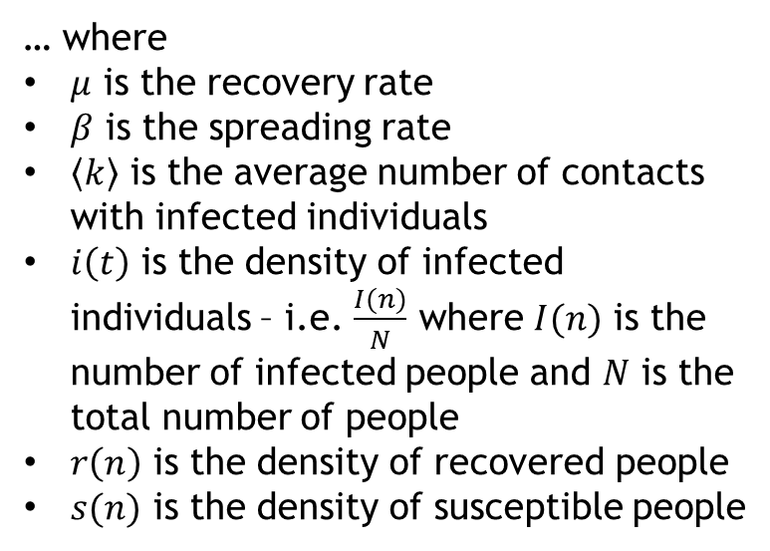

How do you model an epidemic? Model 1: SIR (recovery/vaccination confers immunity)
Susceptible
Infected
Recovered
… where
$μ$ is the recovery rate
$β$ is the spreading rate
$〈k〉$ is the average number of contacts with infected individuals
$i\left(t\right)$ is the density of infected individuals – i.e. $\frac{I(n)}{N}$ where $I(n)$ is the number of infected people and $N$ is the total number of people
$r\left(n\right)$ is the density of recovered people
$s(n)$ is the density of susceptible people
$$\frac{ds(t)}{dt}=−β〈k〉i\left(t\right)[1−r\left(t\right)−i\left(t\right)]$$
$\frac{di(t)}{dt}=−μi\left(t\right)+β〈k〉i(t)[1−r\left(t\right)−i(t)$]
$$\frac{dr(t)}{dt}=μi(t)$$

Slide 34
Model 2: SIS (no vaccine, and recovery does not confer immunity)
Susceptible
Infected

Slide 35

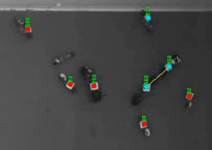
What do active foraging, diseases, and fake news all have in common?
They all spread by contact with someone who’s already “infected” (an active forager, someone who has an illness, someone who believes the fake news, etc.)

Slide 36
We can use epidemic models to model the spread of information, fake news, etc.
Has not heard fake news
Believes fake news
Realizes that they heard fake news (removed from rumor spreading process)

Slide 37
We can even use them to model when foragers become active or quiescent!
Active foragers
Quiescent Foragers

Slide 38
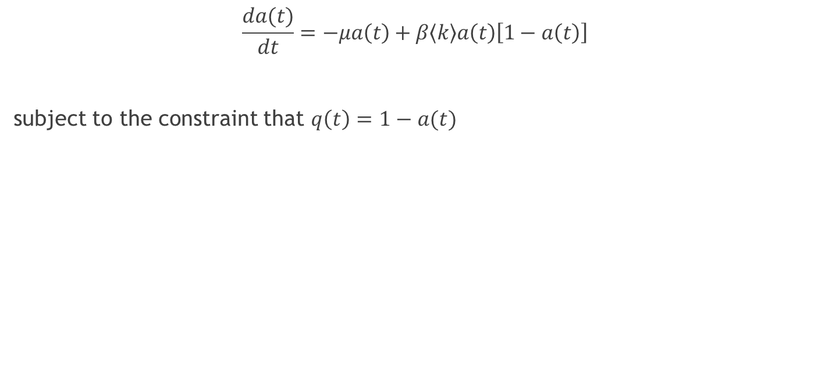
More formally, the QAQ model….
$$\frac{da(t)}{dt}=−μa\left(t\right)+β〈k〉a\left(t\right)\left[1−a\left(t\right)\right]$$
subject to the constraint that $q\left(t\right)=1−a(t)$

Slide 39
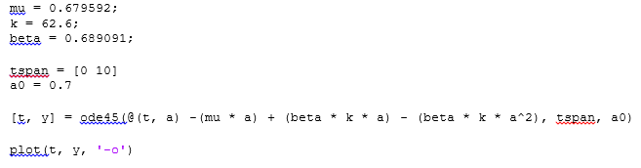
Rather than do the math ourselves…
We could solve this as a separable equation, or we could simply have Matlab do it for us:

Slide 40
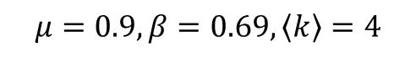
If quiescent foragers meet an average of 4 active foragers within the time period…
$$μ=0.9, β=0.69, 〈k〉=4$$

Slide 41
If they meet three…

Slide 42
Implication:
Ant colonies change their rate of foraging based on the number of foragers that return successfully (but we already knew that)
Both the Ising Model and the epidemic model predict that this change would occur fairly quickly as a result of the local interactions between foragers
While this doesn’t prove that the rapidity of the change is not adaptive, it suggests that it would happen that way for most ant species whether it’s adaptive or not

Slide 43
How do you predict which ants will become foragers?
Train a Supervised Learning algorithm using three metrics for importance:
PageRank (Google algorithm to measure how likely a random web surfer is to end up at a specific node)
Betweenness Centrality (fraction of shortest paths)
Hubness/Authority (pages either link to many other pages)

Slide 44
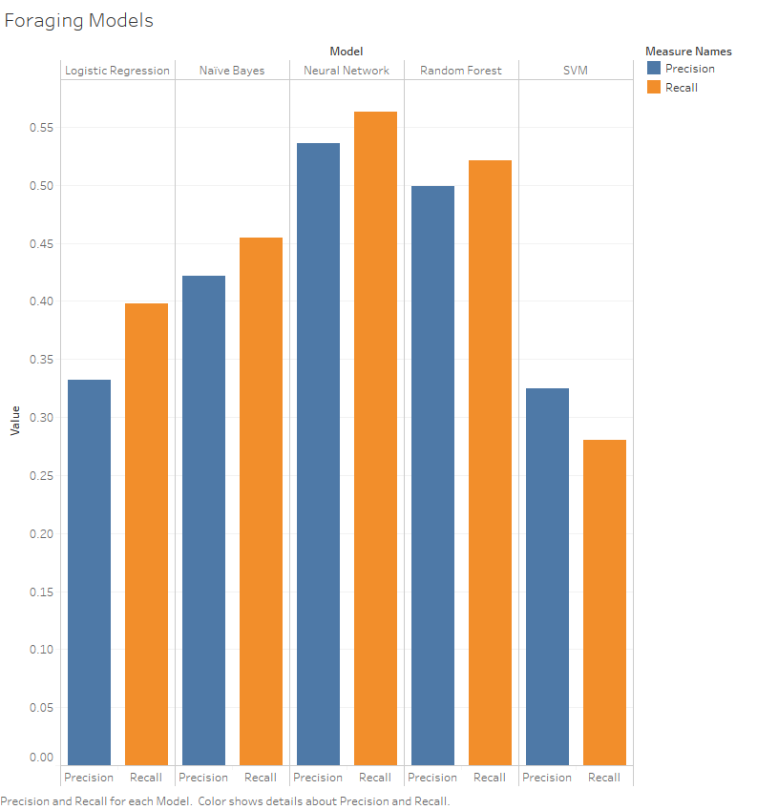

Slide 45
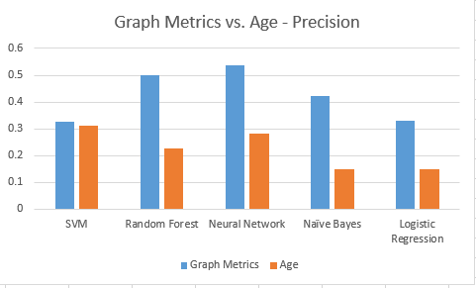
Works much better than colony age…
Source of Variation | SS | df | MS | F | P-value | F crit
Between Groups | 0.0994009 | 1 | 0.0994009 | 13.50693345 | 0.006262537 | 5.317655072
Within Groups | 0.058874 | 8 | 0.00735925
Total | 0.1582749 | 9

Slide 46
Combining them does not appear to improve results much
Source of Variation | SS | df | MS | F | P-value | F crit
Between Groups | 0.002434 | 1 | 0.002434 | 0.199074 | 0.667299 | 5.317655
Within Groups | 0.097797 | 8 | 0.012225
Total | 0.10023 | 9

Slide 47
Other metrics
Which category of ants they’re interacting with (0.9+ precision and recall but somewhat circular)
What their behavioral pattern was in the beginning (precision of 0.688 and recall of 0.741 for Random Forest)

Slide 48
Conclusion
Graph metrics predict when ants become foragers in the first place
Graph-based models predict foraging rates
Foraging rates are very optimal
The speed of the change may or may not contribute to optimality

Slide 49
Acknowledgements
Cover art from The Ants by Bert Holldobler and Edward O. Wilson
Several ant pictures are from Arizona Raft Adventures, Grand Canyon
Desert pictures are from the Wikipedia article on The Joshua Tree

